Slide 1
The One Page Project Manager Developed by Clark A. Campbell
Presented by Tara Bradley
Avera Project Management Conference 2012

Slide 2
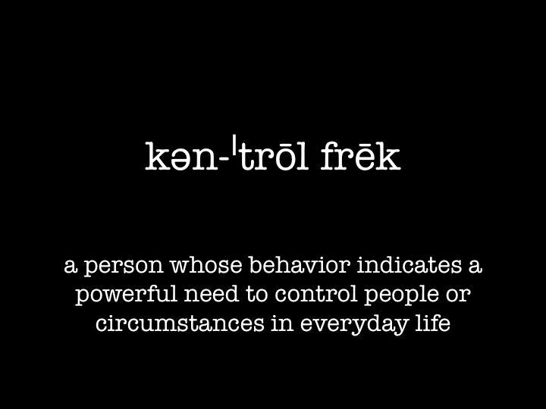

Slide 3


Slide 4
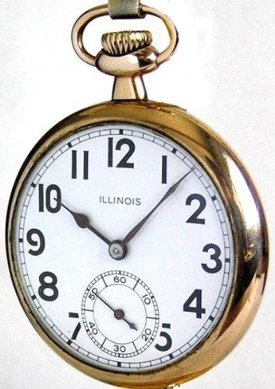

Slide 5


Slide 6



Slide 7
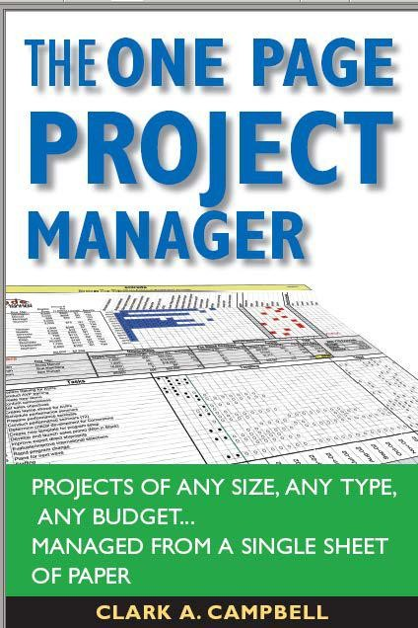
5 Essential Parts
12 Construction Steps
5 Reporting Steps
7

Slide 8












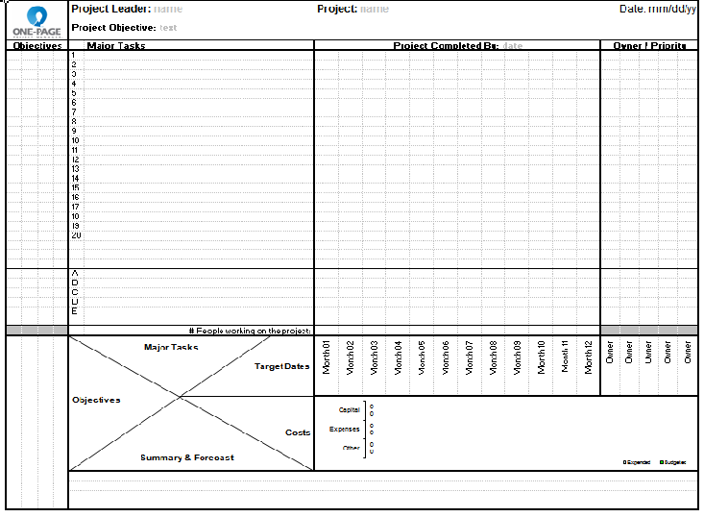


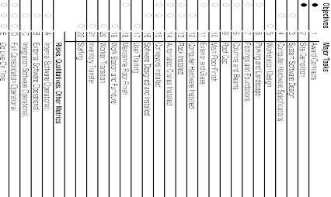
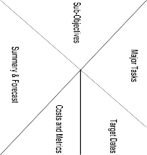

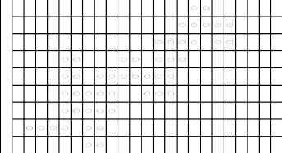


The One-Page OPPM™
Owners
The 5 Essential Parts of a Project
The 12 OPPM™ Construction Steps
The 5 OPPM™ Reporting Steps
Timeline
Plan vs Performance
Tasks
Cost
Budget vs Actual
Objectives
Step 1
Step 6
Step 5
Step 8
Step 9
Step 10
Step 7
Step 2
Step 3
Step 4
Step 11
Step 12

Slide 9
Components
Objectives: The What & Why
Owners: The Who
Tasks: The How
Timeline: The When
Cost: The How Much

Slide 10







Owners
Timeline
Plan vs Performance
Cost
Budget vs Actual
Tasks
Objectives

Slide 11
The 12 Construction Steps
The Header
The Owners
The Matrix
Project objectives
Major project tasks
Aligning tasks with objectives
Target dates
Aligning tasks to timeline
Aligning tasks to owners
Subjective tasks
Costs
Summary and forecast

Slide 12
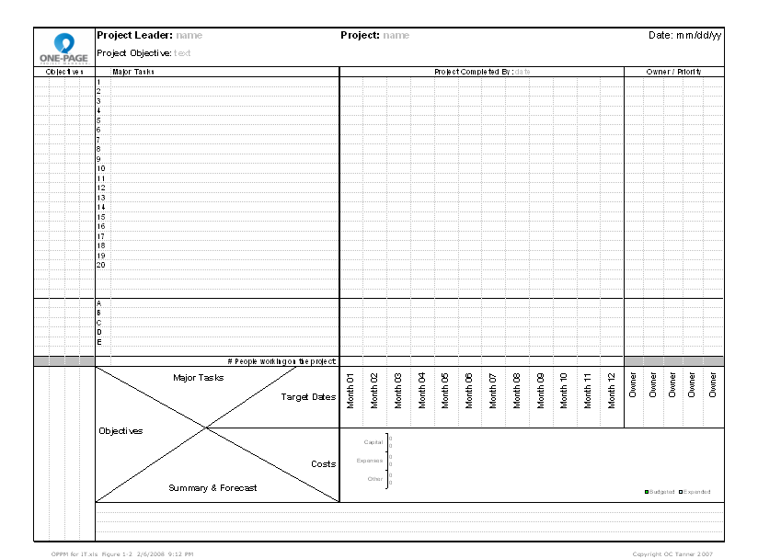
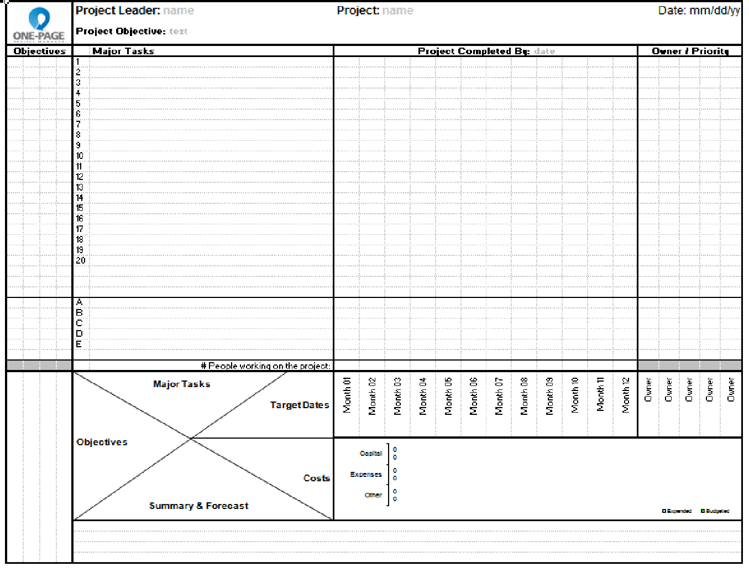
Step 1
Step 5
Step 8
Step 10
Step 7
Step 6
Step 9
Step 2
Step 3
Step 4
Step 11
Step 12

Slide 13
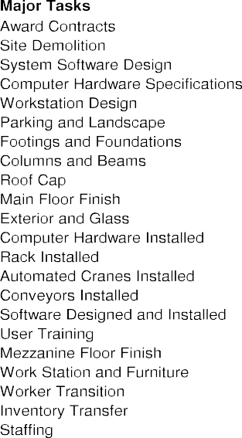
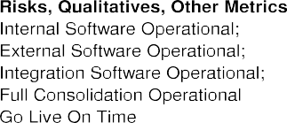

Slide 22



Slide 24


Slide 25
The 5 Reporting Steps
Bold the report date
Fill in major task progress
Designate qualitative performance and risk mitigation
Report expenditures
Write summary and forecast

Slide 26
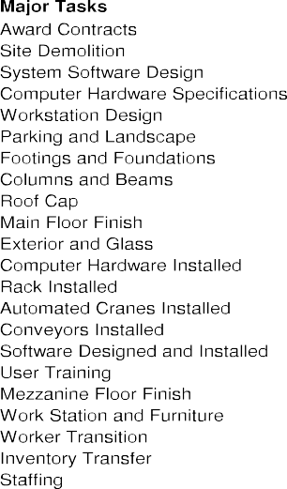










1

Slide 27
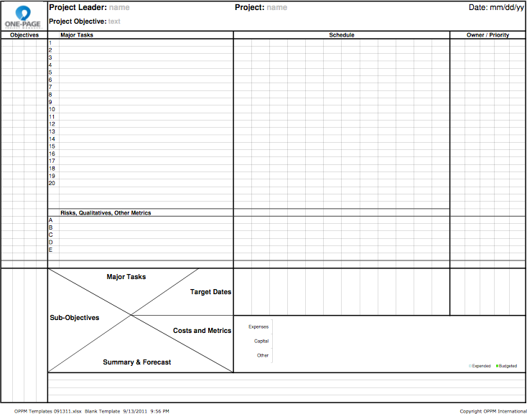

Slide 28
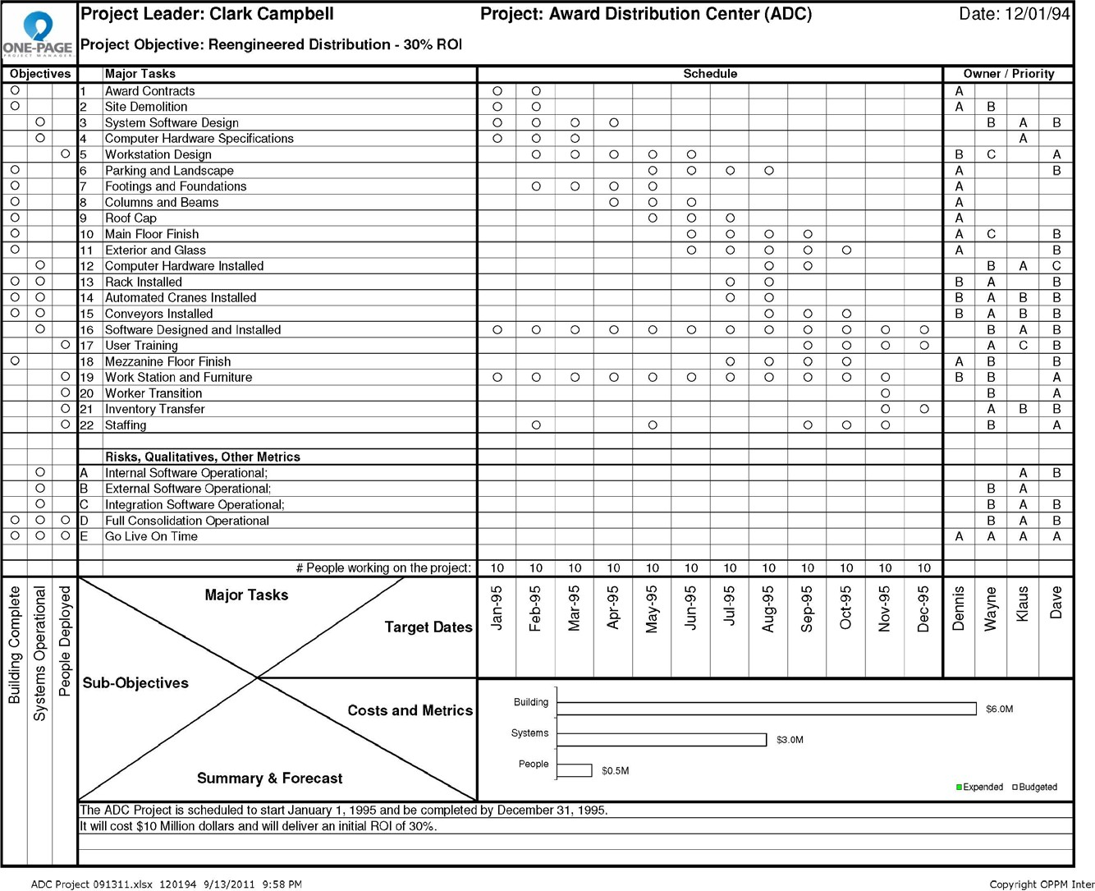

Slide 29
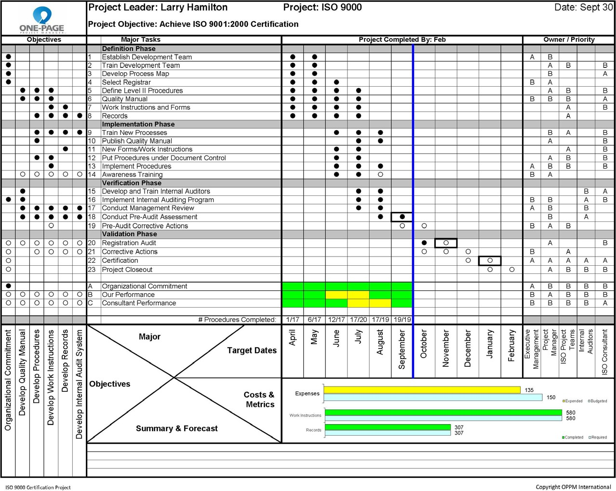

Slide 30
